Slide 1




Online Learning with Limited Information in the Sliding Window Model
Vladimir Braverman
Sumegha Garg
Chen Wang
David P. Woodruff
Samson Zhou

Slide 2







Online Learning with Experts
Fundamental Problem of Sequential Prediction
Day
You
Outcome
1
?
?
$$T$$
2
?
?
3
?
?
$$n$$

Slide 3

Online Learning with Experts
Fundamental Problem of Sequential Prediction
Day
You
Outcome
1
$$T$$
2
?
?
3
?
?

Slide 4

Online Learning with Experts
Fundamental Problem of Sequential Prediction
Day
You
Outcome
1
$$T$$
2
3
?
?

Slide 5
Online Learning with Experts
Fundamental Problem of Sequential Prediction
Day
You
Outcome
1
$$T$$
2
3

Slide 6
Online Learning with Experts
Fundamental Problem of Sequential Prediction
Day
You
Outcome
1
$$T$$
2
3
1 mistake

Slide 7
Online Learning with Experts
Fundamental Problem of Sequential Prediction
Day
You
Outcome
1
$$T$$
2
3
1 mistake
1 mistake
2 mistakes
1 mistake
1 mistake

Slide 8
Online Learning with Experts
Fundamental Problem of Sequential Prediction
Regret: # of mistakes by algorithm- # of mistakes by best expert
Day
You
Outcome
1
2
3
1 mistake
1 mistake
2 mistakes
1 mistake
1 mistake

Slide 9
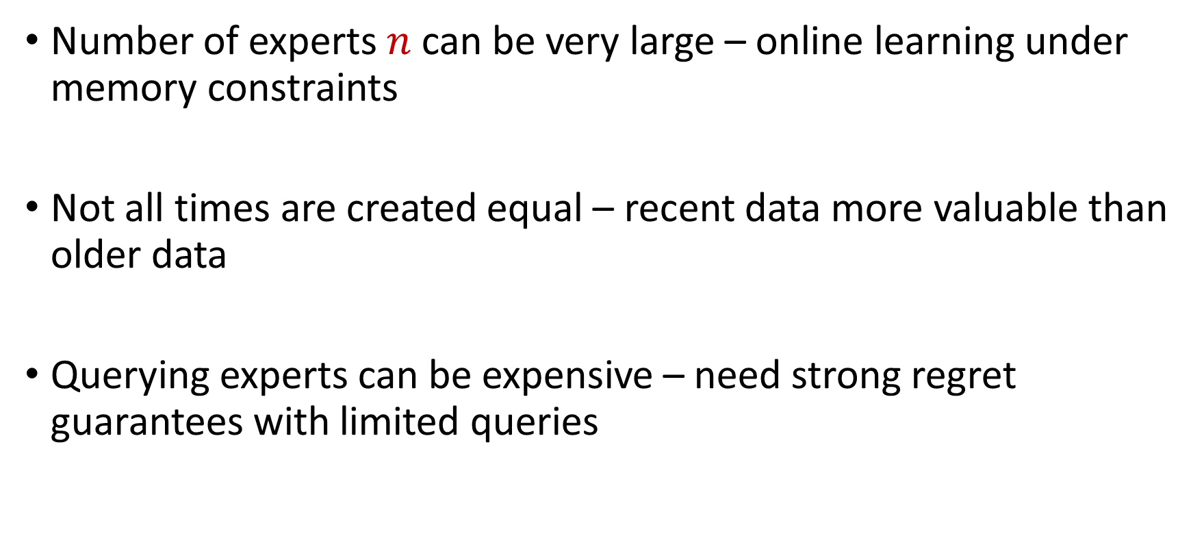
Challenges and Motivation
Number of experts $n$ can be very large – online learning under memory constraints
Not all times are created equal – recent data more valuable than older data
Querying experts can be expensive – need strong regret guarantees with limited queries

Slide 10
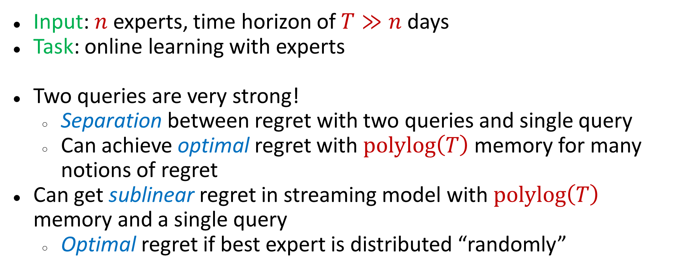
Preview of Results
Input: $n$ experts, time horizon of $T≫n$ days
Task: online learning with experts
Two queries are very strong!
  Separation between regret with two queries and single query
  Can achieve optimal regret with $polylog\left(T\right)$ memory for many notions of regret
Can get sublinear regret in streaming model with $polylog\left(T\right)$ memory and a single query
  Optimal regret if best expert is distributed “randomly”

Slide 11
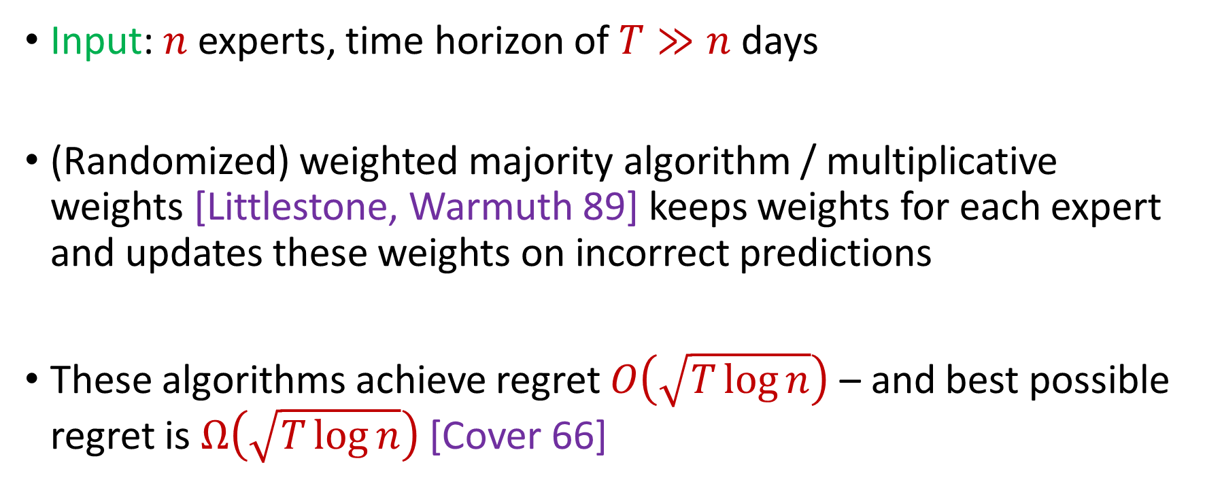
Classic Experts Problem
Input: $n$ experts, time horizon of $T≫n$ days
(Randomized) weighted majority algorithm / multiplicative weights [Littlestone, Warmuth 89] keeps weights for each expert and updates these weights on incorrect predictions
These algorithms achieve regret $O\left(\sqrt{T\log{n}}\right)$ – and best possible regret is $Ω\left(\sqrt{T\log{n}}\right)$ [Cover 66]

Slide 12

Resource Constraints (Query Complexity)
Small query complexity, ideally just a single query per time, i.e., bandit setting
Classical algorithms, e.g., EXP3, achieve regret $\tilde{O}\left(\sqrt{nT}\right)$, which is known to be optimal [Auer, Cesa-Bianchi, Fruend-Schapire 02]

Slide 13

Resource Constraints (Memory)
Large $n$ and $T$, sublinear memory desired
Sequence of works [Srinivas, Woodruff, Xu, Zhou 22], [Peng, Zhang 23], [Aamand, Chen, Nguyen, Silwal 23], [Peng, Rubinstein 23] culminating in near-optimal regret ${\tilde{O}}_{n}\left(\sqrt{T}\right)$ using $polylog\left(T\right)$ memory

Slide 14
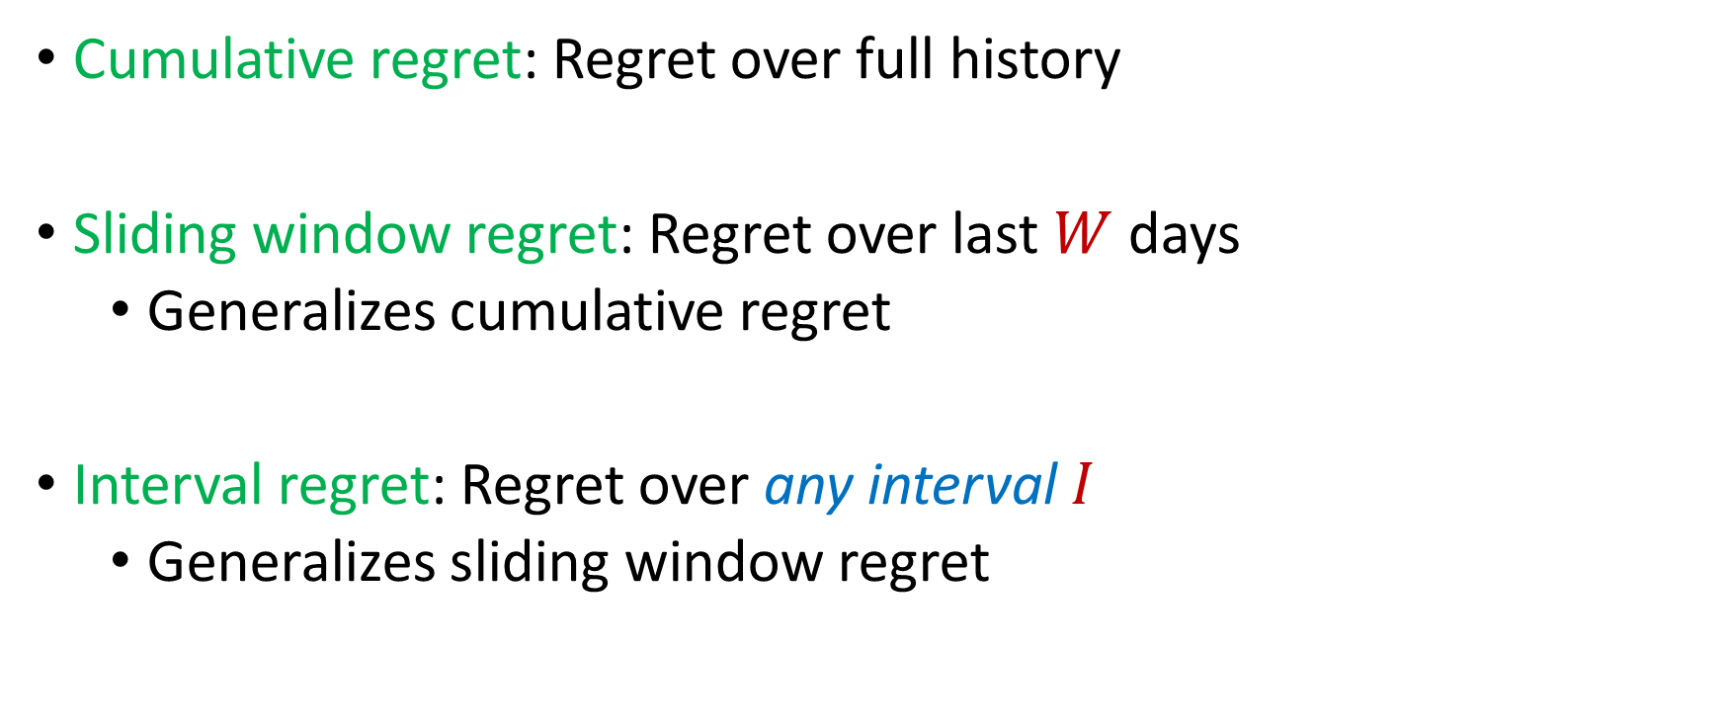
Regret Notions
Cumulative regret: Regret over full history
Sliding window regret: Regret over last $W$ days
  Generalizes cumulative regret
Interval regret: Regret over any interval $I$
  Generalizes sliding window regret

Slide 15
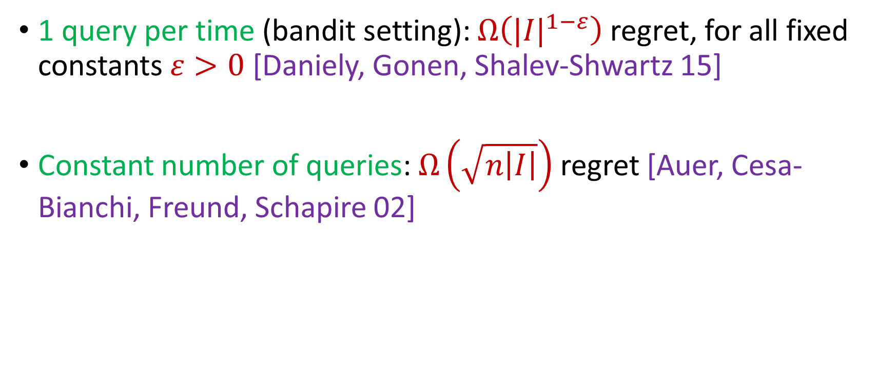
Lower Bounds for Interval Regret
1 query per time (bandit setting): $Ω\left({|I|}^{1−ε}\right)$ regret, for all fixed constants $ε>0$ [Daniely, Gonen, Shalev-Shwartz 15]
Constant number of queries: $Ω\left(\sqrt{n\left|I\right|}\right)$ regret [Auer, Cesa-Bianchi, Freund, Schapire 02]

Slide 16
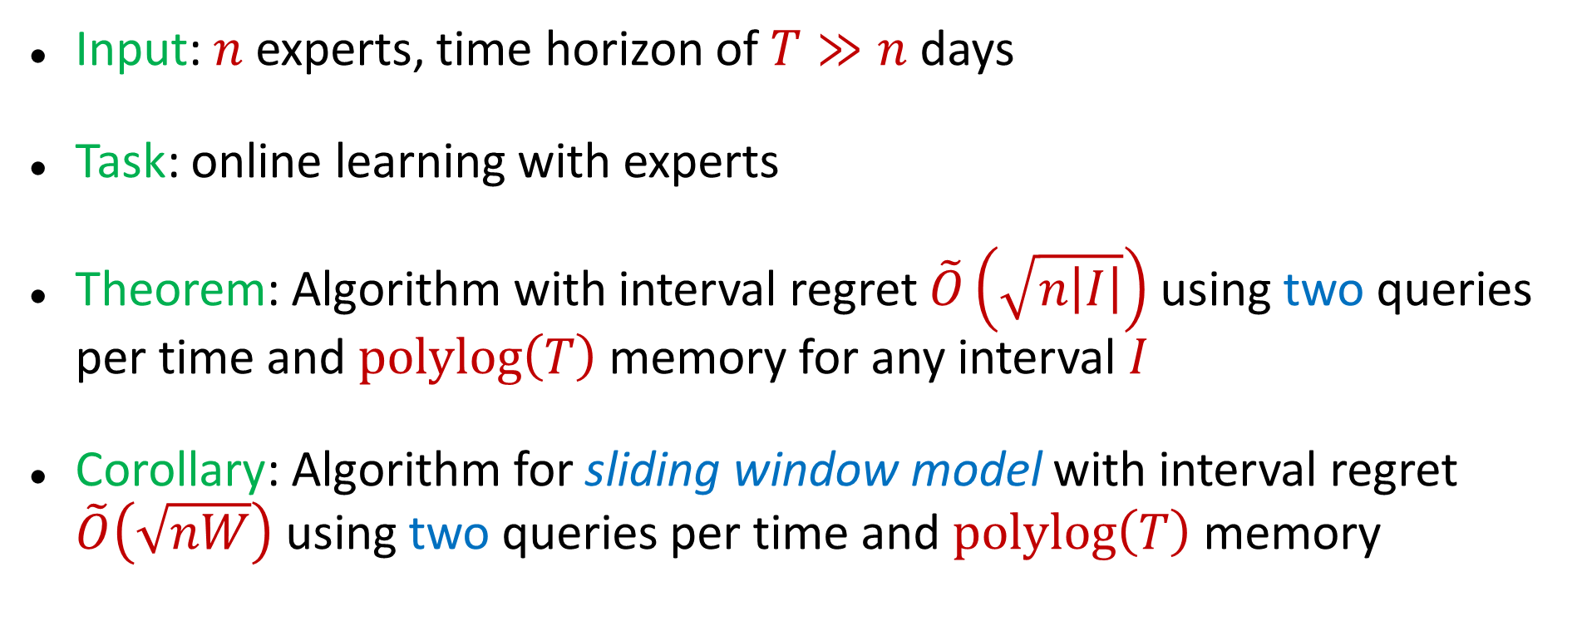
Our Results (I)
Input: $n$ experts, time horizon of $T≫n$ days
Task: online learning with experts
Theorem: Algorithm with interval regret $\tilde{O}\left(\sqrt{n\left|I\right|}\right)$ using two queries per time and $polylog\left(T\right)$ memory for any interval $I$
Corollary: Algorithm for sliding window model with interval regret $\tilde{O}\left(\sqrt{nW}\right)$ using two queries per time and $polylog\left(T\right)$ memory

Slide 17
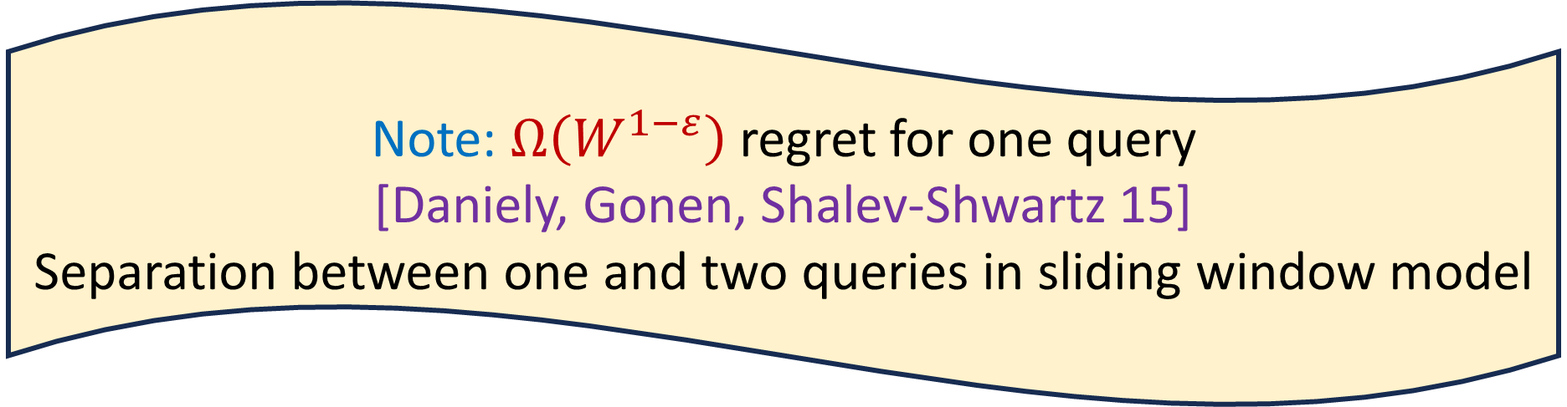
Our Results (I)
Input: $n$ experts, time horizon of $T≫n$ days
Task: online learning with experts
Theorem: Algorithm with interval regret $\tilde{O}\left(\sqrt{n\left|I\right|}\right)$ using two queries per time and $polylog\left(T\right)$ memory for any interval $I$
Corollary: Algorithm for sliding window model with interval regret $\tilde{O}\left(\sqrt{nW}\right)$ using two queries per time and $polylog\left(T\right)$ memory
Note: $Ω\left(W^{1−ε}\right)$ regret for one query
[Daniely, Gonen, Shalev-Shwartz 15]
Separation between one and two queries in sliding window model

Slide 18
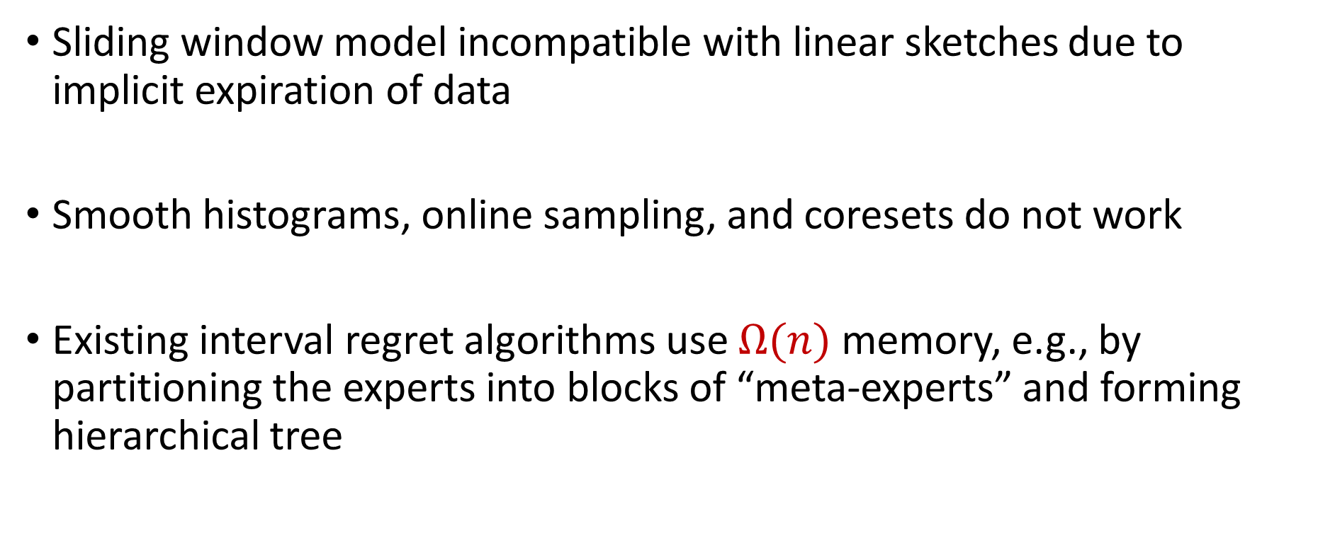
Sliding Window Technical Challenges
Sliding window model incompatible with linear sketches due to implicit expiration of data
Smooth histograms, online sampling, and coresets do not work
Existing interval regret algorithms use $Ω(n)$ memory, e.g., by partitioning the experts into blocks of “meta-experts” and forming hierarchical tree

Slide 19
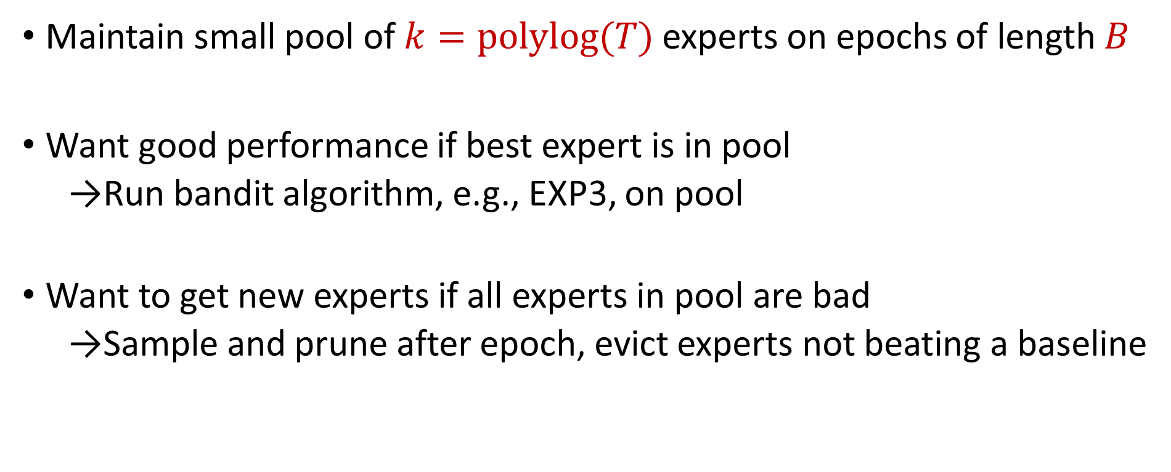
Sampling and Pruning
Maintain small pool of $k=polylog(T)$ experts on epochs of length $B$
Want good performance if best expert is in pool
  Run bandit algorithm, e.g., EXP3, on pool
Want to get new experts if all experts in pool are bad
  Sample and prune after epoch, evict experts not beating a baseline

Slide 20
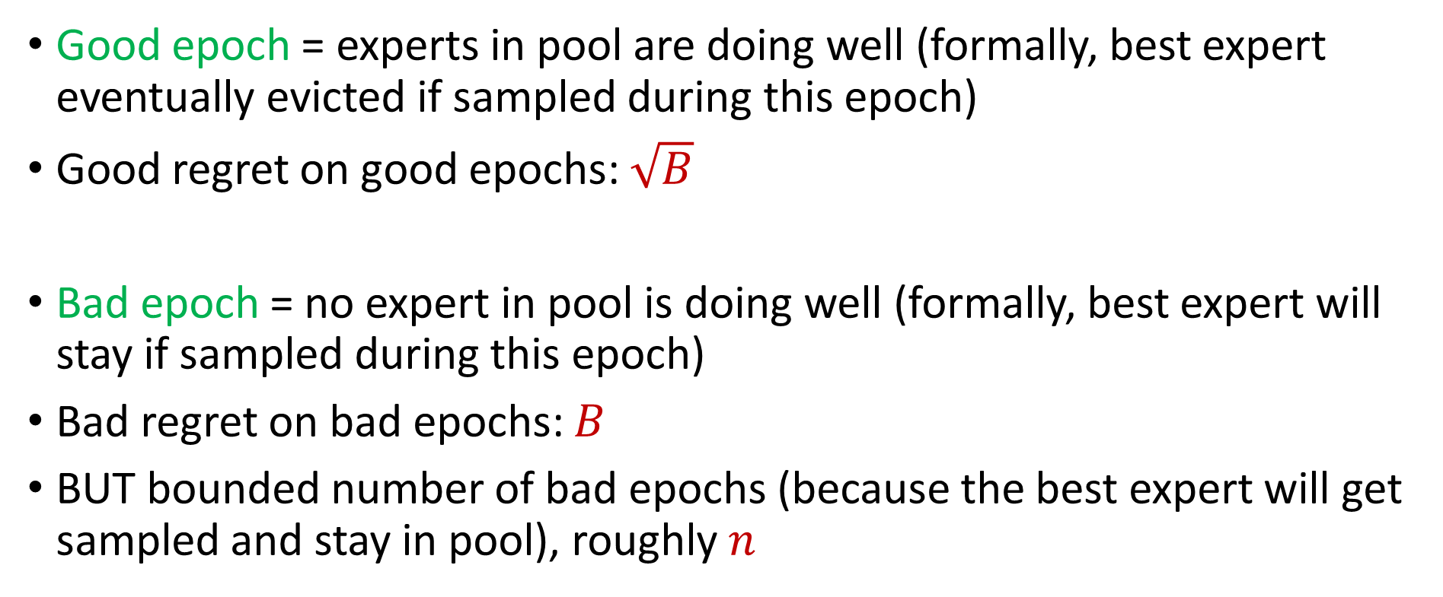
Good vs. Bad Epochs
Good epoch = experts in pool are doing well (formally, best expert eventually evicted if sampled during this epoch)
Good regret on good epochs: $\sqrt{B}$
Bad epoch = no expert in pool is doing well (formally, best expert will stay if sampled during this epoch)
Bad regret on bad epochs: $B$
BUT bounded number of bad epochs (because the best expert will get sampled and stay in pool), roughly $n$

Slide 21
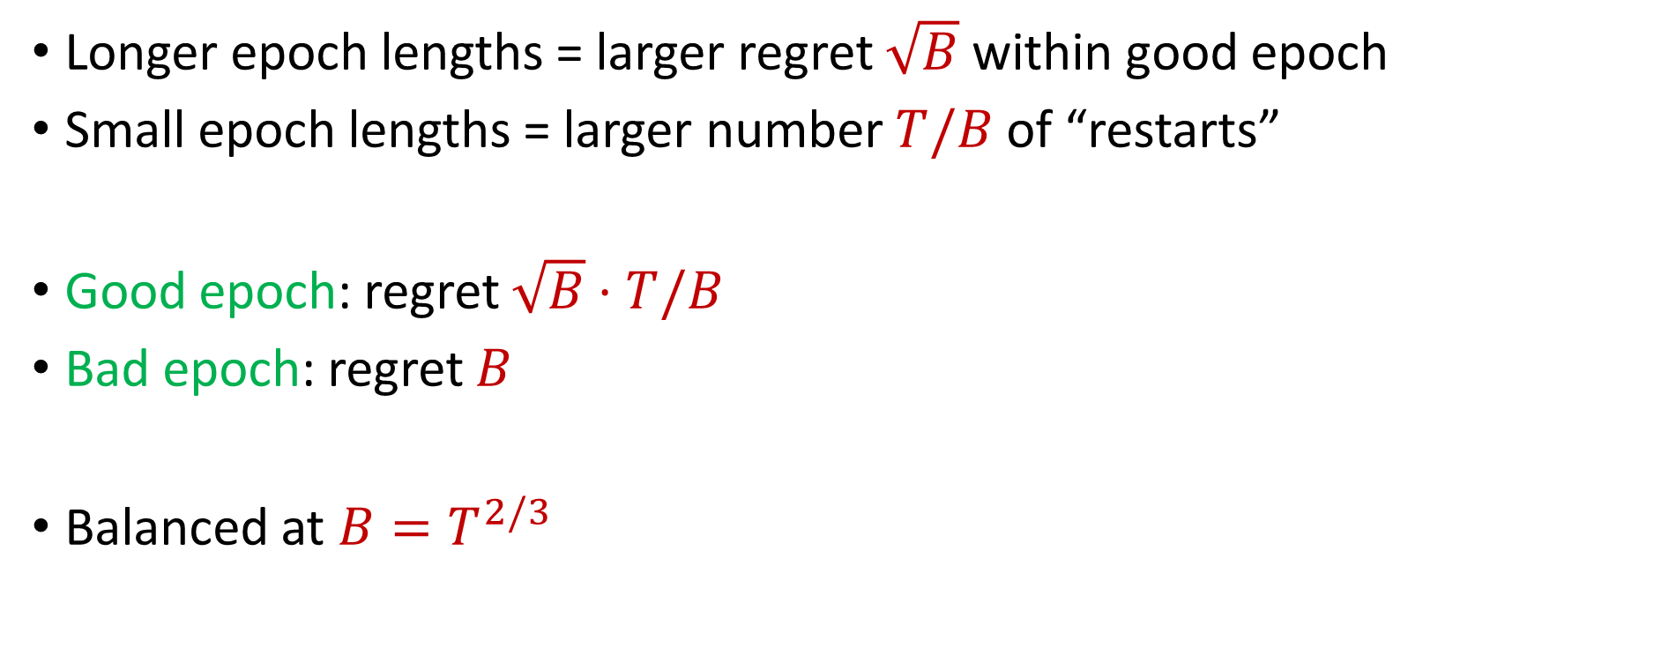
Baseline Tradeoff
Longer epoch lengths = larger regret $\sqrt{B}$ within good epoch
Small epoch lengths = larger number $T/B$ of “restarts”
Good epoch: regret $\sqrt{B}⋅T/B$
Bad epoch: regret $B$
Balanced at $B=T^{2/3}$

Slide 22
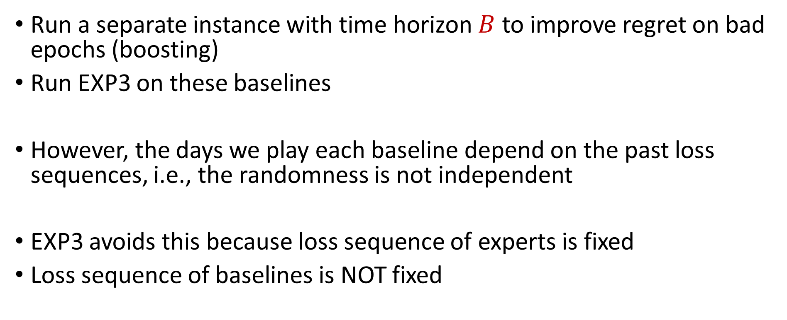
Boosting and Correlated Dependencies
Run a separate instance with time horizon $B$ to improve regret on bad epochs (boosting)
Run EXP3 on these baselines
However, the days we play each baseline depend on the past loss sequences, i.e., the randomness is not independent
EXP3 avoids this because loss sequence of experts is fixed
Loss sequence of baselines is NOT fixed
Notes:
We need good estimates at all times to ensure best expert stays in pool / bad experts are evicted from pool

Slide 23
Two-Query Fix and Interval Regret
Key insight: separate learning and playing
Fix exploration randomness
Query 1: Play expert
Query 2: Uniform estimation on experts and baselines
Interval regret: Algorithms for geometrically sized intervals
Outer controller: Run EXP3 / MWU on these intervals

Slide 24
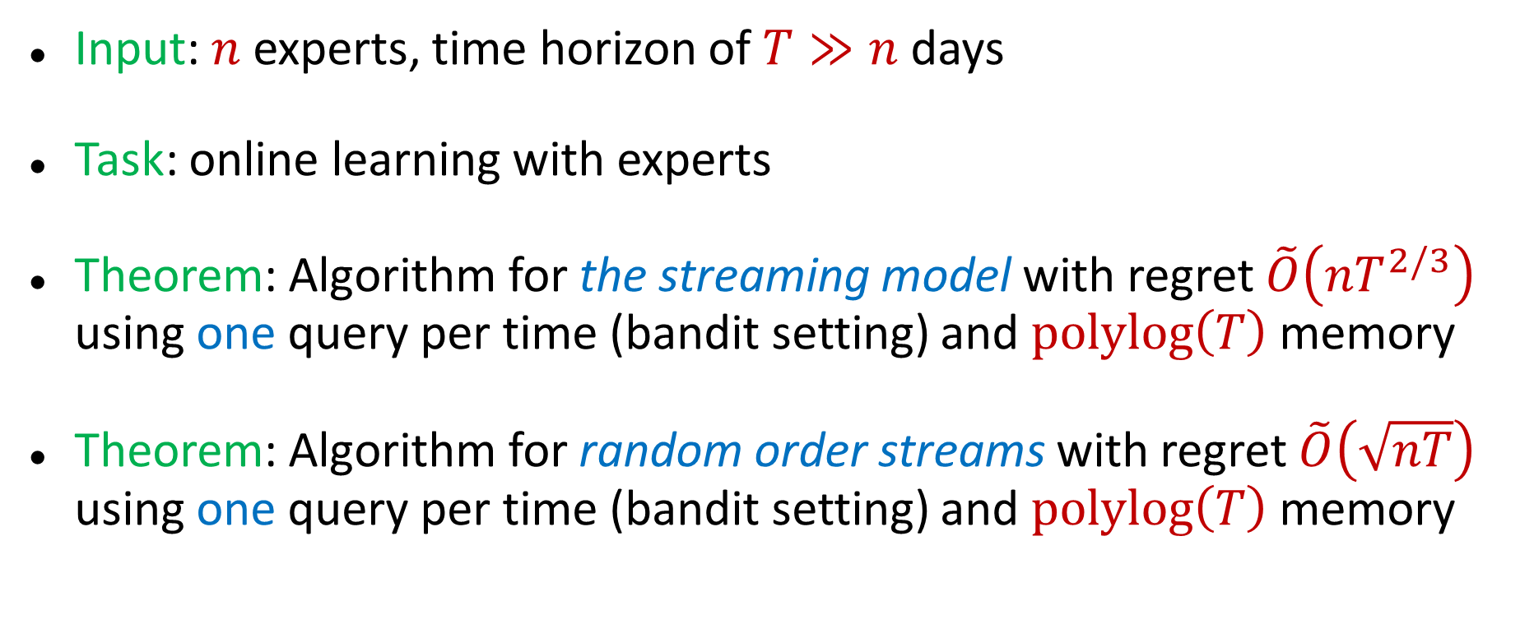
Our Results (II)
Input: $n$ experts, time horizon of $T≫n$ days
Task: online learning with experts
Theorem: Algorithm for the streaming model with regret $\tilde{O}\left(nT^{2/3}\right)$ using one query per time (bandit setting) and $polylog\left(T\right)$ memory
Theorem: Algorithm for random order streams with regret $\tilde{O}\left(\sqrt{nT}\right)$ using one query per time (bandit setting) and $polylog\left(T\right)$ memory

Slide 25
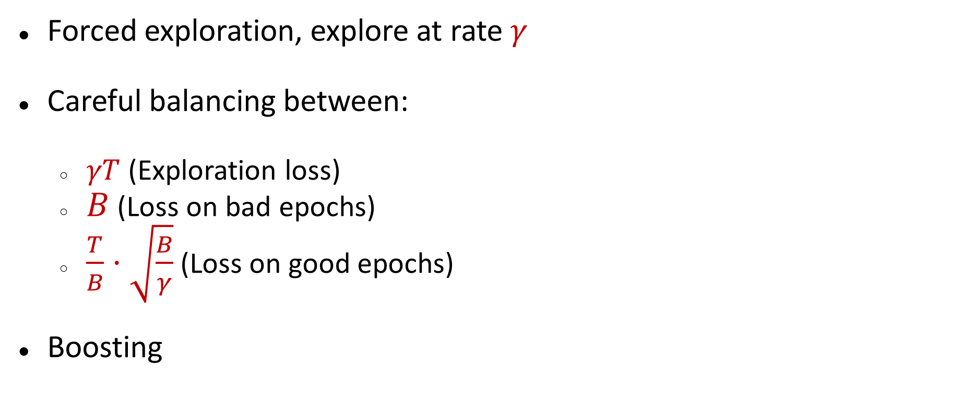
Single Query Technique
Forced exploration, explore at rate $γ$
Careful balancing between:
  $γT$ (Exploration loss)
  $B$ (Loss on bad epochs)
  $\frac{T}{B}⋅\sqrt{\frac{B}{γ}}$ (Loss on good epochs)
Boosting

Slide 26
Random-Order Algorithm
Best expert losses permuted (weaker assumption)
Search for the “correct” error rate of the best expert, starting low and going high
Cycle through all experts and check whether the loss exceeds the desired error rate
If a bad expert “fakes” having a good error rate, we get “negative” regret!

Slide 27

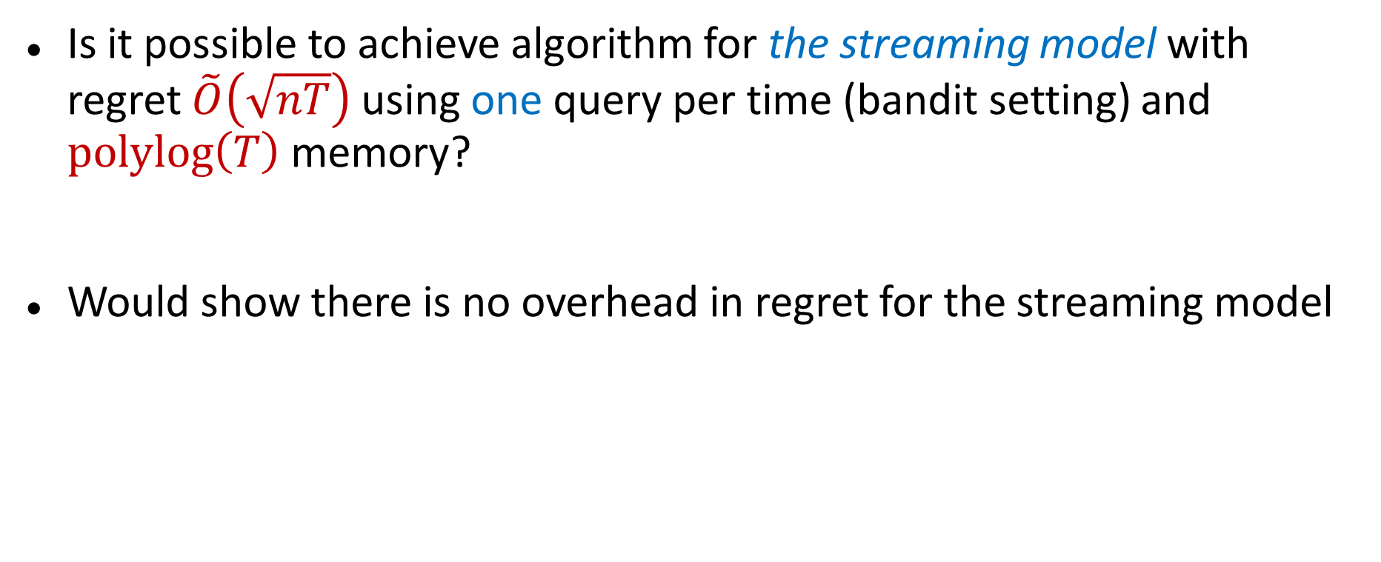
Future Work?
Is it possible to achieve algorithm for the streaming model with regret $\tilde{O}\left(\sqrt{nT}\right)$ using one query per time (bandit setting) and $polylog\left(T\right)$ memory?
Would show there is no overhead in regret for the streaming model

Slide 28
Applications
Ensemble learning, e.g., AdaBoost
Forecast and portfolio optimization
Special case of online convex optimization

Slide 29
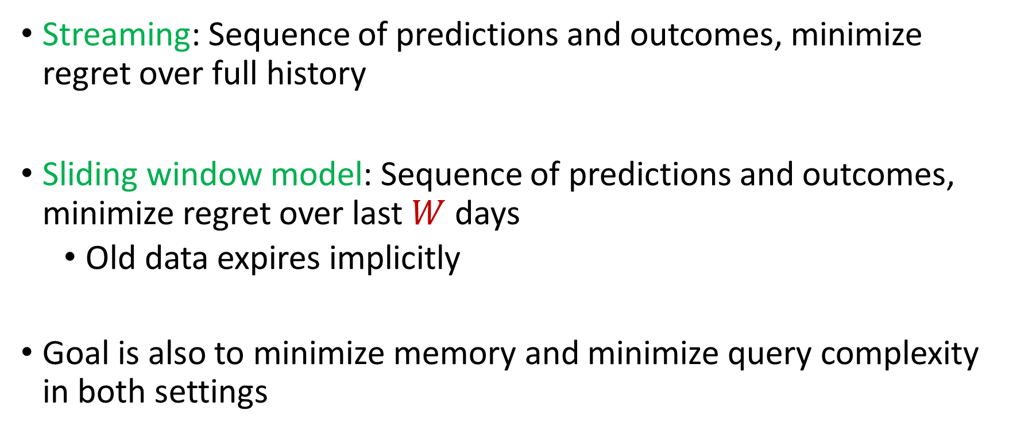
Streaming vs. Sliding Window
Streaming: Sequence of predictions and outcomes, minimize regret over full history
Sliding window model: Sequence of predictions and outcomes, minimize regret over last $W$ days
  Old data expires implicitly
Goal is also to minimize memory and minimize query complexity in both settings

Slide 30
Why Interval Regret?
Strong adaptability
Handles non-stationarity
Implies sliding window bounds

